Slide 1
The AMOS Coach
Dirk Riehle, Univ. Erlangen
COACH A02
Licensed under CC BY 4.0 International

Slide 2
Agenda
The AMOS project
The AMOS coach
The AMOS capabilities timeline
The AMOS coach’s worklog
The AMOS agile review

Slide 3
1. The AMOS Project

Slide 4
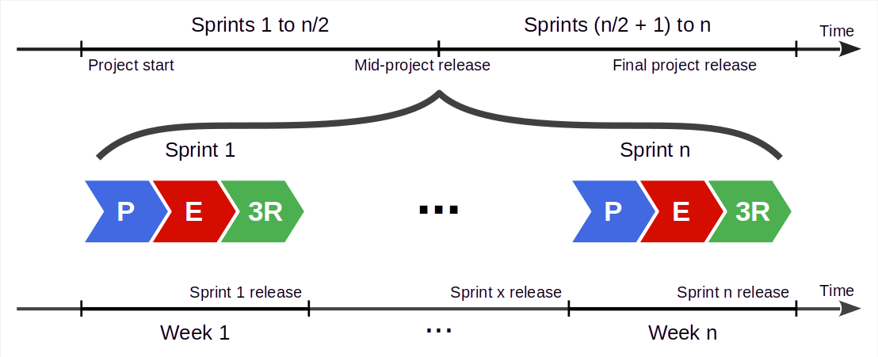
AMOS Project Timeline [1]
[1] See slide deck AMOS B02 - Scrum and AMOS

Slide 5
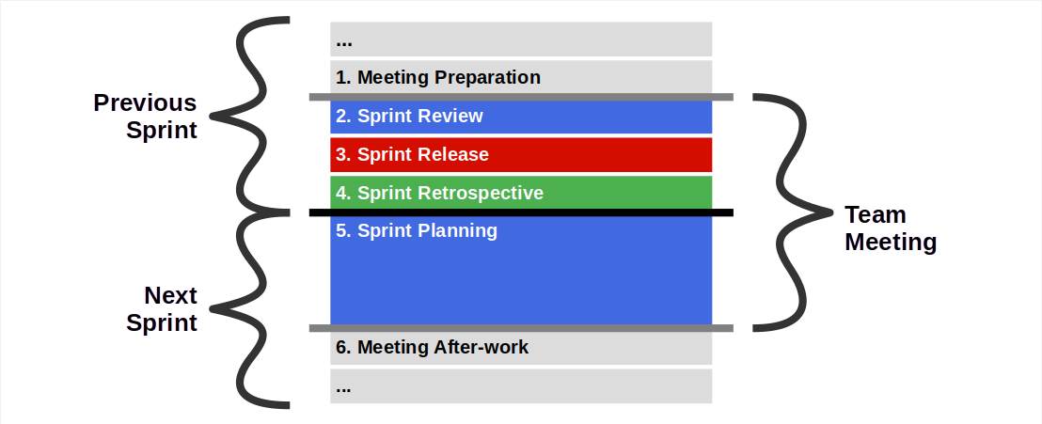
The AMOS Team Meeting [1]
[1] See slide deck AMOS B02 - Scrum and AMOS

Slide 6
Challenges of Scrum in a University Setting
Assumption | Reality
Full-time on project | Part-time (⅓ of weekly work)
Equal abilities | Abilities can vary greatly
Some extrinsic motivation | Short-term extrinsic motivation (grades)
Long-term perspective | Teams disband after project
General familiarity | May never have met before

Slide 7
AMOS Timeline and Levels of Competence
by final release
Unconscious competence
Right intuition
Conscious competence
Right analysis
Conscious incompetence
by mid-project release
Wrong analysis
Unconscious incompetence
decides to join The AMOS Project
Wrong intuition

Slide 8
2. The AMOS Coach

Slide 9
Engagement Model
Two related roles
Scrum Master (of an AMOS project)
Workshop facilitator (for AMOS team)

Slide 10
Scrum Master
Act as Scrum Master
During team meetings
Participate in role
Fill in happiness index
During the sprint
Perform work
Write stand-up emails
Scrum Master tasks
Contribute as Scrum Master
Follow AMOS capabilities timeline

Slide 11
COACH Retrospectives
We will perform weekly retrospectives with you
All coaches will share their experiences with each other and us
Such retrospectives are private to the course
Please do not share them with your AMOS team (different course)

Slide 12
Workshop Facilitator
As a workshop facilitator
Prepare your workshop concept
Provide feedback on other concepts
Hold and report about your workshop

Slide 13
3. The AMOS Capabilities Timeline

Slide 14
Scrum Terminology / Shorthands
Shorthand | Long form
PO | Product owner
SD | Software developer
SM | Scrum master
TM | Team member
RM | Release manager
HI | Happiness index

Slide 15
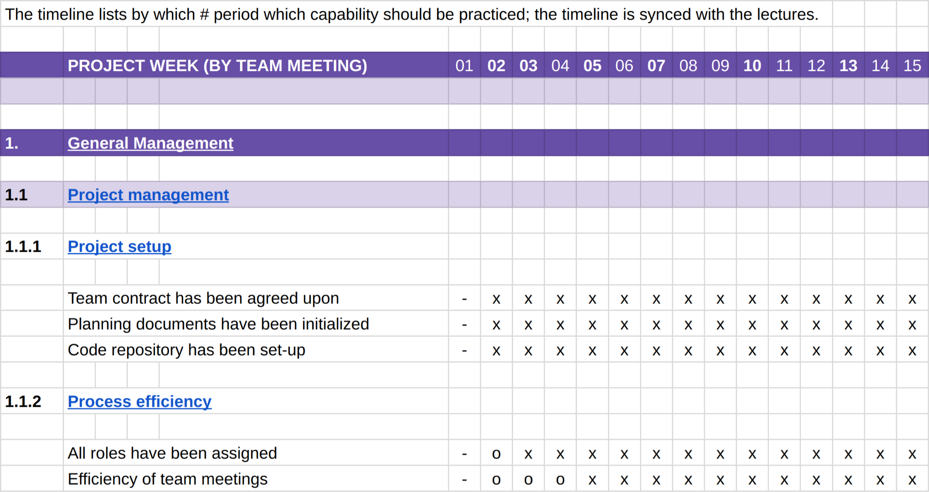
The AMOS Capabilities Timeline [1]
– Unknown, not relevant
o Known, not practiced
x Should be practiced
[1] See Capabilities Timeline (by Week) and Capabilities Timeline Explained

Slide 16
How to Take Notes in the Capabilities Timeline
In (your copy of) the capability timeline, for the given team meeting, mark a
0: for practice not performed
1: practice performed below expectations
2: practice performed according to expectations
3: practice performed above expectations
If practice is somehow not applicable, don’t add / change anything

Slide 17
Use of Marks in Capabilities Timeline
For a 0 (practice not performed), you may
Have to teach the team about it
Want to inform the AMOS instructor about it
For a 1 (practice performed below expectations), you should
Explain in your public notes what was missed
Explain how to do better
For a 3 (practice performed above expectations ) you should
Point out what went well and why
Encourage team to keep going

Slide 18
4. The AMOS Coach’s Worklog

Slide 19
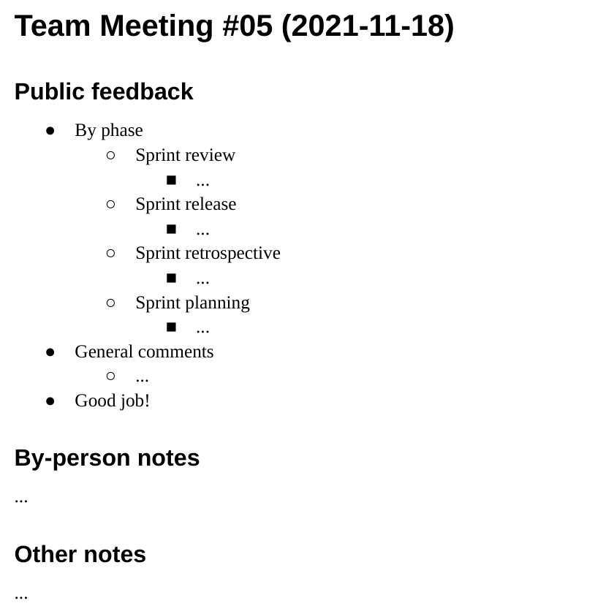
The AMOS Coach’s Worklog
An AMOS coach takes free form notes in a worklog structured by team meetings
Please copy the worklog template

Slide 20
How to Take Notes in the Worklog
For each out of the ordinary (0, 1, 3) value for a practice
Take notes in the corresponding section
Public notes: To be sent to the AMOS team
Private notes: For your own use
For the common value (2), if you feel it is beneficial,
Say “good job” and / or encourage to push further

Slide 21
Example Capability and Worklog Notes
Example: For “Sprint release candidate has been tagged properly” = 1,
Write in the “Sprint review” section of your worklog
“Please do not rename the release candidate to become the release tag; rather set a new tag”
Example: For “Quality of playing planning poker” = 1,
Write in the “Sprint planning” section of your worklog
“Some of you simply accepted what others said; don’t do that, please engage. If you see someone not actively contributing, please try to pull them in”
“It is tempting, but please don’t just take the average story point value; go at least for two rounds if there is no immediate agreement, before resorting to averages”
Use the “What can go wrong” notes in the Timeline Explained document!

Slide 22
5. The AMOS Agile Review

Slide 23
The AMOS Agile Review
The AMOS agile review is
A review of a team’s ability to follow the (AMOS) Scrum process
Performed in writing for each team meeting during the project

Slide 24
When and How to Give Verbal Feedback
At the end of a team meeting, optionally and if time permits,
Verbally provide feedback for session (from work log)
Answer any questions the team might have
It is your right (and duty) to do so
At the end of the team meeting
At the 90 min. mark
whichever comes first

Slide 25
How to Take Notes and Give Written Feedback
Track observations and insights in your worklog, as discussed
In written agile review, prefer roles (SD, PO) over person names
Please cc: all other coaches and teaching team
Due (the latest) at the end of team meeting day

Slide 26
What is Public and What is Not
The templates and explanations are all publicly available
Capabilities timeline (by week)
Capabilities timeline explained
The AMOS coach’s worklog
Your copy of the documents is not!
Please only share your public comments

Slide 27
Summary
The AMOS project
The AMOS coach
The AMOS capabilities timeline
The AMOS coach’s worklog
The AMOS agile review

Slide 28
Thank you! Any questions?
dirk.riehle@fau.de – https://oss.cs.fau.de
dirk@riehle.org – https://dirkriehle.com – @dirkriehle

Slide 29
Legal Notices
License
Licensed under the CC BY 4.0 International license
Copyright
© Copyright 2024 Dirk Riehle, some rights reserved

